Slide 1
Database as a service(DaaS)
Databases are repositories for information with links within the information that help make the data searchable.
Distributed databases, like Amazon’s SimpleDB, spread information among physically dispersed hardware.
But to the client, the information seems to be located in one place

Slide 2
Advantages of such a database include the following:
Improved Availability - If there is a fault in one database system, it will only affect one fragment of the information, not the entire database.
Improved Performance - Data is located near the site and the database systems are parallelized, allows the load balancing among servers.
Price - Less expensive to create a network of smaller computers with the power of one large one.
Flexibility - Systems can be changed and modified without harm to the entire database.

Slide 3
Database Services
DaaS – is another “as a service” in CC. The idea behind DaaS is to avoid the complexity and cost of running your own database.
DaaS offers these benefits:
Ease of use - No Need to buy , install, and maintain hardware for the database.
Power - The database isn’t housed locally, but that doesn’t mean that it is not functional and effective. Depending on your vendor, you can get custom data validation to ensure accurate information. You can create and manage the database with ease.
Integration - The database can be integrated with your other services to provide more value and power. For instance, you can tie it in with calendars, email, and people to make your work more powerful.
Management - can be provided as part of the service for much less expense.

Slide 4
There are a number of providers : Few Major Ones Are :
MS SQL
Oracle

Slide 5
MS SQL
Microsoft’s SQL Server
Introduced Microsoft SQL Server Data Services (SSDS) in 2009
SSDS and Amazon’s SimpleDB are similar in terms of : Schema-Free data storage, SOAP or REST APIs, and a Pay-as-you-go payment system.
SSDS integrates with Microsoft’s Sync Framework, which is a .NET library for synchronizing dissimilar data sources.
Microsoft wants SSDS to work as a data hub, synchronizing data on multiple devices so they can be accessed offline.
There are three core concepts in SSDS:
Authority - An authority is both a billing unit and a collection of containers.
Container - A container is a collection of entities and is what you search within.
Entity - An entity is a property bag of name and value pairs.

Slide 6
Oracle
SSDS is a bit of a twist because it backsteps from being more complex, rather being simple and flexible.
Oracle introduced three services to provide database services to cloud users.
Customers can license :
Oracle Database 11g
Oracle Fusion Middleware
Oracle Enterprise Manager
The products are available for use on Amazon EC2
Oracle delivered a set of free Amazon Machine Images (AMIs) to its customers so they could quickly and efficiently deploy Oracle’s database solutions.

Slide 7
Developers can take advantage to rapidly build applications using Oracle’s popular development tools such as :
Oracle Application Express
Oracle JDeveloper
Oracle Enterprise Pack for Eclipse
Oracle Workshop for WebLogic
Oracle Unbreakable Linux Support and AWS Premium Support is available for Oracle Enterprise Linux on EC2, providing seamless customer support.

Slide 8
Oracle introduced a secure cloud-based backup solution.
Oracle Secure Backup Cloud Module enables customers to use Amazon S3 as their database backup destination.
Oracle Secure Backup Cloud Module also enables encrypted data backups to help ensure complete privacy in the cloud environment.
It’s fully integrated with Oracle Recovery Manager and Oracle Enterprise Manager, providing users with familiar interfaces for cloud-based backups.
For customers with an ongoing need to quickly move very large volumes of data into or out of the AWS cloud, Amazon allows the creation of network peering connections

Slide 9
Security Concerns in cloud computing
That is, if another party is housing all your data, how do you know that it’s safe and secure?
- As a starting point, assume that anything you put on the cloud can be accessed by anyone.
There are also concerns because law enforcement has been better able to get at data maintained on a cloud, more so than they are from an organization’s servers.

Slide 10
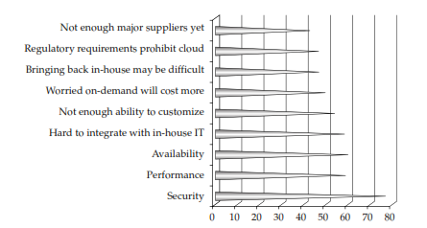
Privacy Concerns with a Third Party

Slide 11
Hackers
try to break into a secure network just because they can
They want something.
There’s a lot they can do if they’ve compromised your data. It ranges from selling your proprietary information to your competition to surreptitiously encrypting your storageuntil you pay them off.
Or they may just erase everything to damage your business and justify the action based on their ideological beliefs.
hackers are a real concern for your data managed on a cloud.
Because your data is held on someone else’s equipment, you may be at the mercy of whatever security measures they support.

Slide 12
Bot Attackers
In a commonly recognized worst-case scenario, attackers use botnets to perform distributed denial of service (DDOS) attacks.
In order to get the hackers to stop attacking your network, you face blackmail.

Slide 13
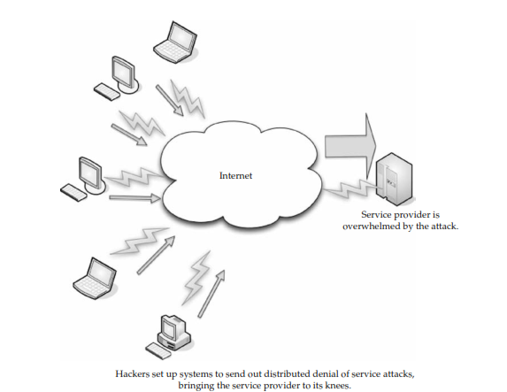

Slide 14
Security Benefits
Need some very strong security practices to safeguard data in cloud.
Centralized Data
Reduced Data Loss
More than 12,000 laptops are lost in American airports every year.
It’s bad enough to lose your data
Some bad companies - lose proprietary data or other mission-critical information.
Also, how many laptops employ really strong security measures, like whole-disk data encryption? If the laptop can be effectively compromised, the information will be in the hands of the thief.
By maintaining data on the cloud, employing strong access control, and limiting employee downloading to only what they need to perform a task, cloud computing can limit the amount of information that could potentially be lost.
Monitoring - If your data is maintained on a cloud, it is easier to monitor security than have to worry about the security of numerous servers and clients.
Of course, the chance that the cloud would be breached puts all the data at risk, but if you are mindful of security and keep up on it, then we worry about one location, rather than sever

Slide 15
Instant Swapover –
When we perform the swapover, it’s seamless to
your users. You don’t have to spend hours trying to replicate the data or fix the breach.
Abstracting the hardware allows you to do it instantly.
Logging
In the cloud, logging is improved.
On a cloud, you don’t need to guess how much storage you’ll need and you will likely maintain logs
Also, we can use more advanced logging techniques.
Secure Builds
When you developed your own network, you had to buy third-party security software toget the level of protection you want.
With a cloud solution, those tools can be bundled in and available to you and you can develop your system with whatever level of security you desire.
Also, you can perform your patches and upgrades offline.
As you patch a server image, you can keep it safe offline, and when you are ready to put the virtual machine online, you can conveniently do that.
Finally, the ability to test the impact of your security changes is enhanced.
Simply perform and offline-test the version of your production environment.

Slide 16
Improved Software Security
Vendors are likely to develop more efficient security software.
But charges for our CPU cycles
As such, the vendor doesn’t want to lose your business and is going to be more inclined to develop more efficient security software.
Security Testing
SaaS providers don’t bill you for all of the security testing they do.
It’s shared among the cloud users.
Realize that lower costs exist for security testing.
This is also the case with PaaS where your developers create their own code, but the cloud code–scanning tools check the code for security weaknesses.

